Slide 1
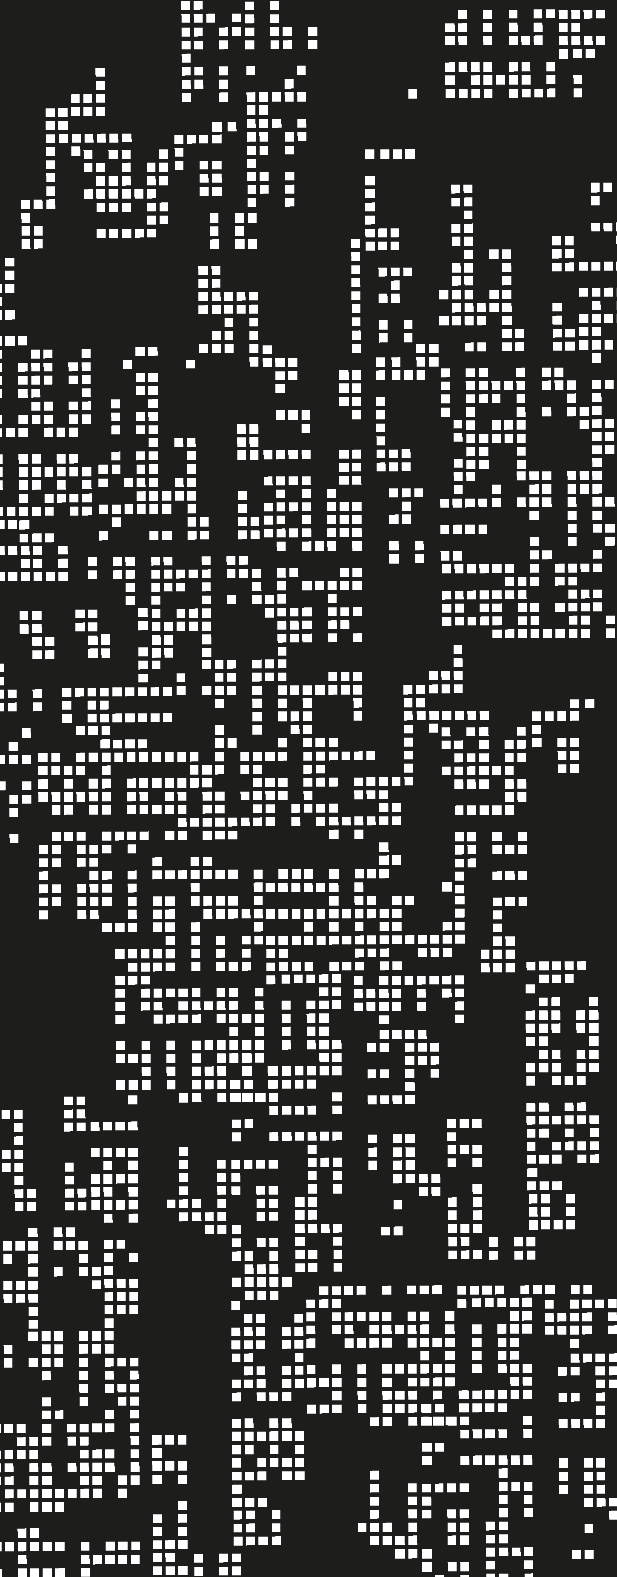
Substitution + Functions
Variables and with

Slide 2
Agenda
01
Extensions using FP
02
with
03
Implementing identifiers

Slide 3
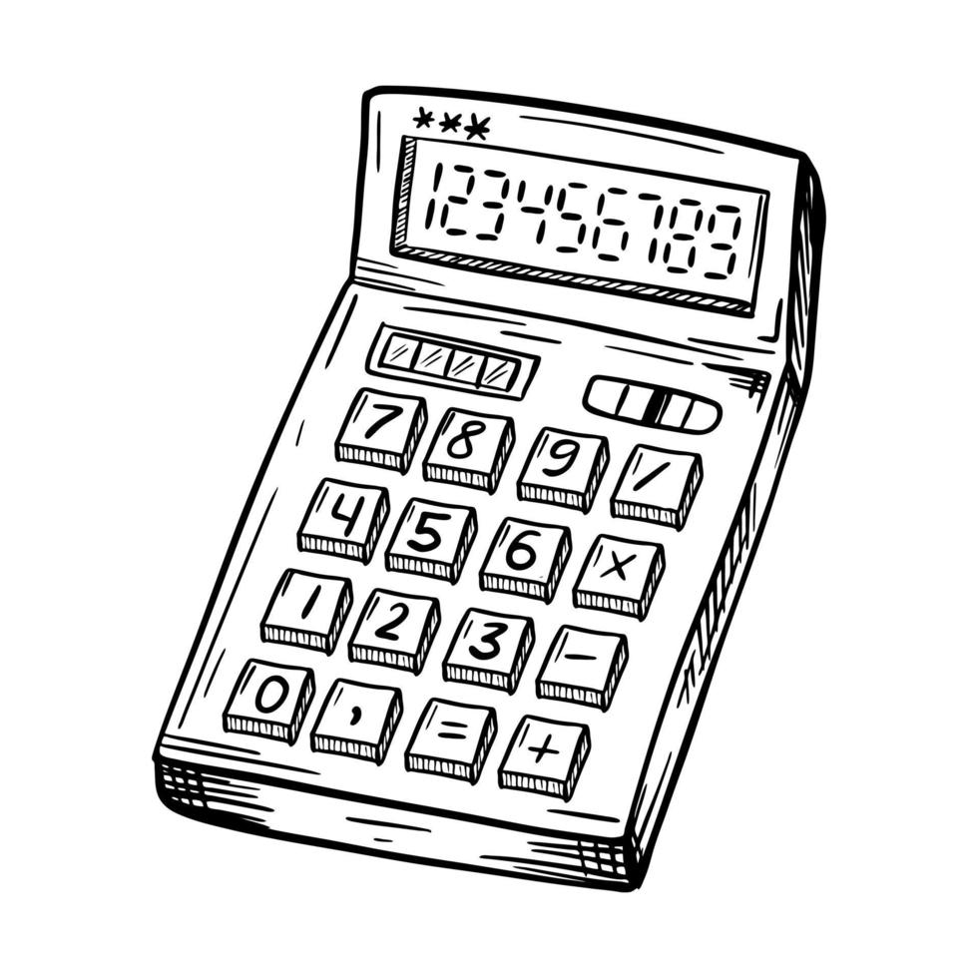

Extensions
So, AE is a good language. However, it is a very basic calculator, for now.
And you’ve extended a little.
Extend mult and neg
Booleans
Type Checker
Now, lets try some new things:
How to make infix notation?
Support strings + string append
Support infinite multiplication

Slide 4

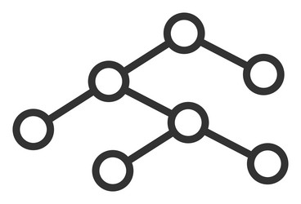
How to introduce extensions?
4. Actualizar comportamiento en el intérprete
3. Actualizar parser
parse
interp
Val
src
expr
1. Definir sintaxis concreta
2. Definir correspondiente sintaxis abstracta

Slide 5
But, is it enough?
numbers
AE
booleans

Slide 6
But, is it enough? No, it is too basic
variables
numbers
AE
conditionals
booleans
functions
loops

Slide 7
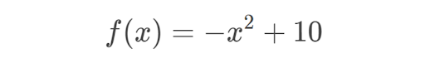
But, let’s take it step by step
What do we need first? Something vital:
Variables
So, how would we define a variable? Let's take an example of mathematics. What if I want to know f(2), f(6)?

Slide 8
Variables
Right! To solve the equation, we needed to substitute the x value on the expression.
Here comes a new concept for variable usage: substitution
Remember let on Racket? We’ll we are going to extend or model with our own let but, we’ll call it with, therefore, our language will evolve
AE
WAE

Slide 9
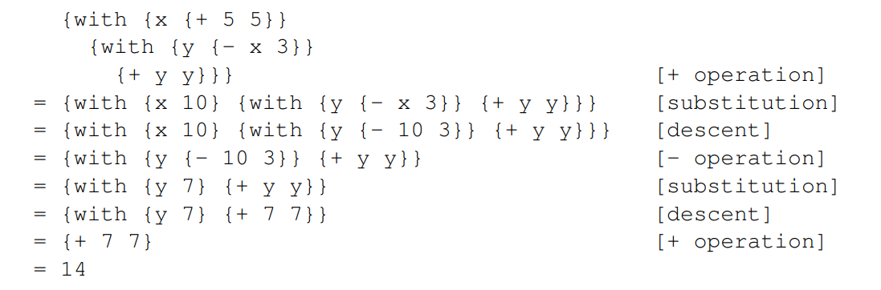
How does substitution work?

Slide 10
So, first definition of substitution
Substituir x por v en e es reemplazar las ocurrencias de x en e por v
Firma de subst:
Subst:: <id> <expr> <expr> -> <expr>
Lo que devuelve es una expresión, por lo que subst trabaja principalmente en el AST.

Slide 11
analyze
transform [subst is part of this]
parse
interp
Value
compile
optimize
Source Code
AST
exec
IR (bytecode)
ExprL2
Church - Turing

Slide 12
Theory Summary
References
To use variables, we need to implement substitution, which allows us to replace the variables by their variables.
The substitution works on expressions, therefore, it is made while or before interpreting, but it never does the work of the interpreter.
PLAI, chapter 4 (S. Krisnamurthi)

